Slide 1
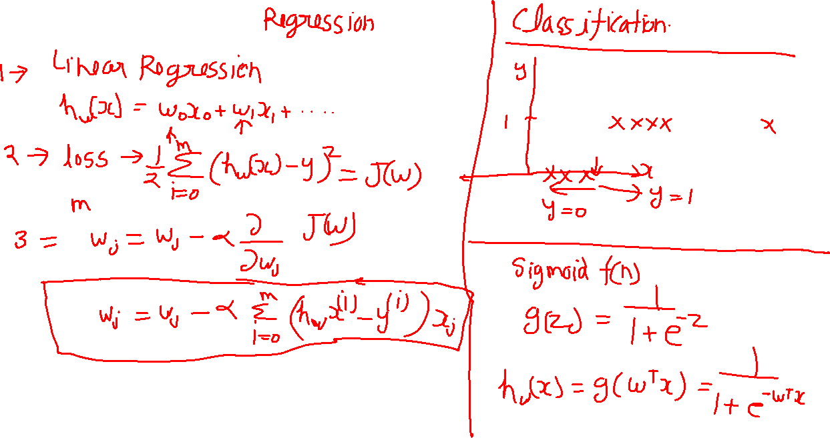
Recap

Slide 2
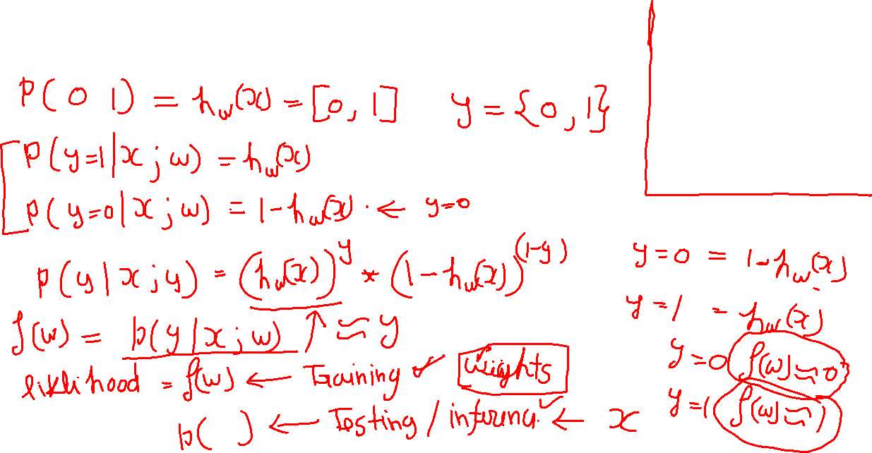
Loss function for classification

Slide 3
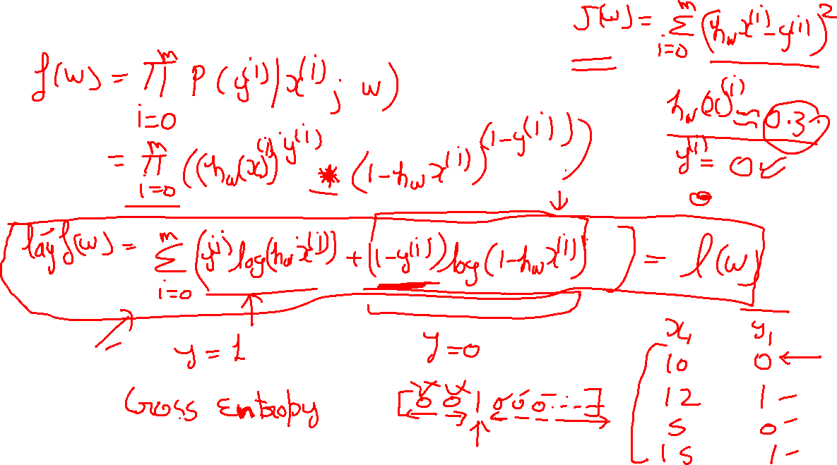
Hypothesis for classification

Slide 4
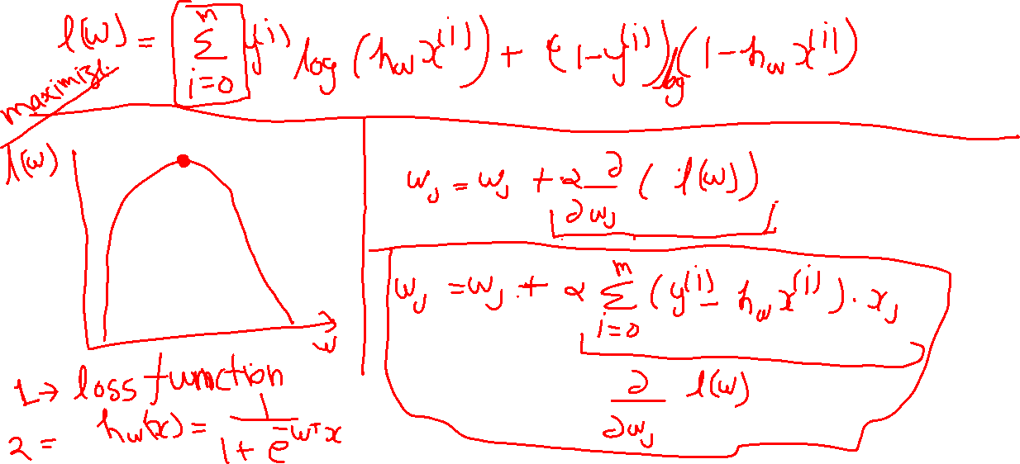

Gradient ascent

Slide 5
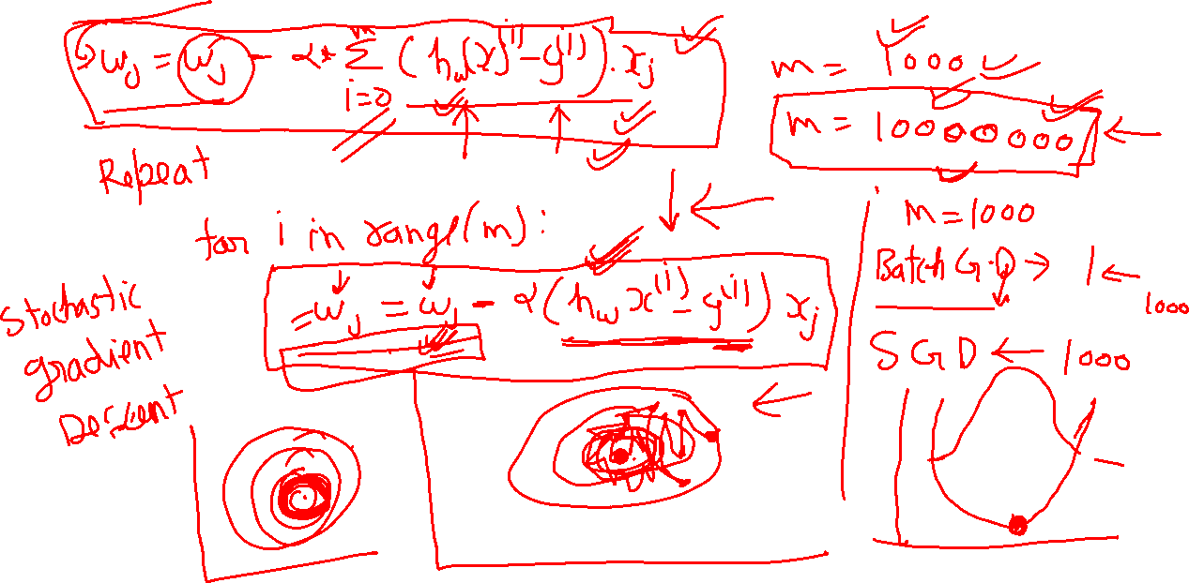
Batch Gradient descent & Stochastic Gradient Descent

Slide 6
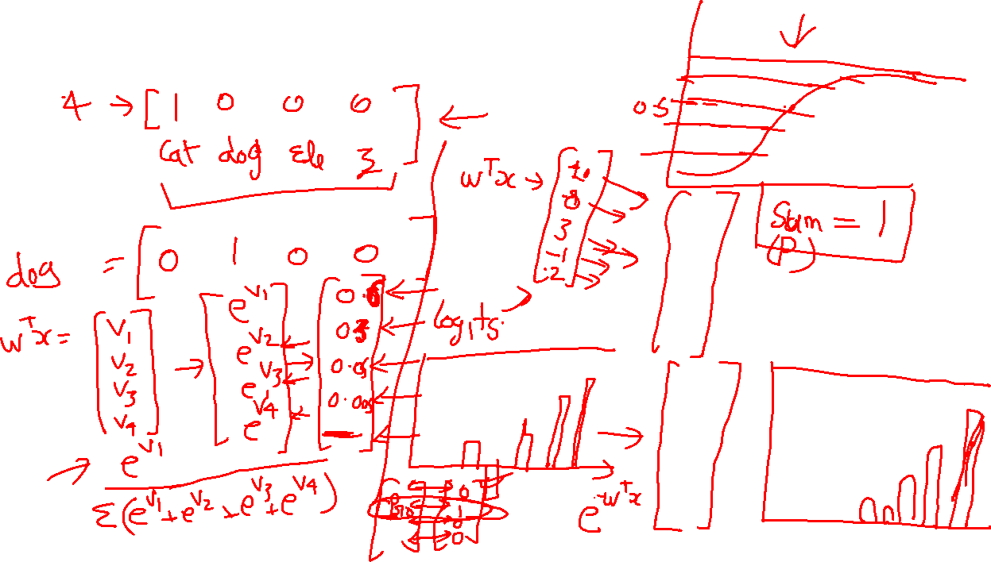
Softmax (Multiclass Classification)

